Slide 1
Markov Chains
Dr. Sk. Md. Masudul Ahsan
Professor, Dept. of CSE, KUET
Md. Shahidul Salim
Lecturer, Dept. of CSE, KUET

Slide 2
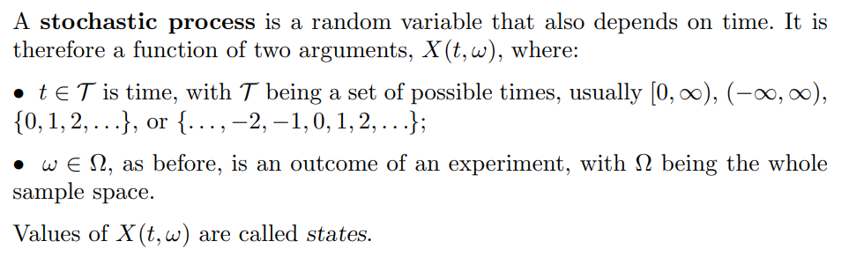
stochastic process

Slide 3
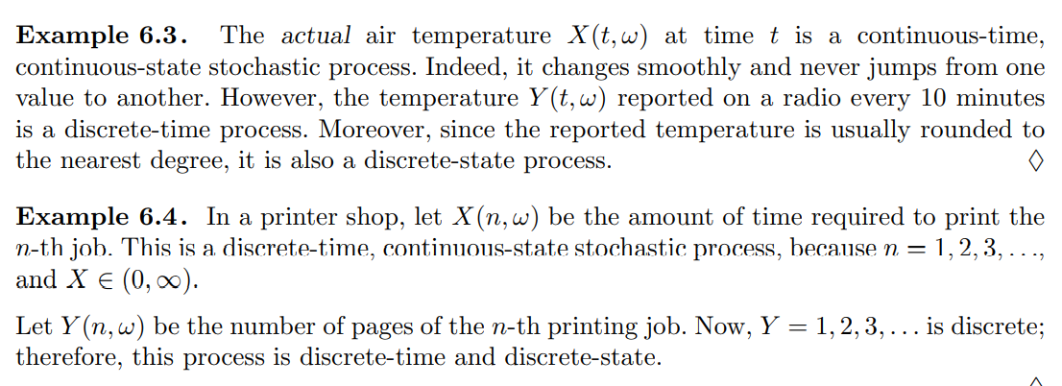
Stochastic Process
Values assumed by X_{t} are called states, set of all possible values of states constitute state space (S)
If state space is
Discrete – called discrete-state process or chain
Continuous - called continuous-state process
If index set T is
Discrete – called discrete-time process or sequence
Continuous - called continuous-time process

Slide 4
Markov Chain
Markov Property: a stochastic process is said to have ~ if probability distribution of future state depends only on present state and not on how the process arrived in that state.
Formally-The state of the system at time t+1 depends only on the state of the system at time t
A stochastic process {X_{t}} having Markov property is called Markov Process
Markov chain -If the state space of a Markov process is discrete
If index set is also discrete – Discrete-time Markov chain
What we are interested in

Slide 5
Stationary Markov Chain
Stationary Assumption: For all states i, j and for all t, P(X_{t+1} = j |X_{t} = i) is independent of time (t)
P(X_{t+1} = j |X_{t} = i) = P(X₁ = j |X₀ = i) = p_{ij}
; i,j = 0,1, …, s; t = 0,1, …,T
This means that if system is in state i, the probability that the system will transition to state j is pij no matter what the value of t is
p_{ij} = probability that the system will be in state j at time t+1 given that it is in state i at time t
Called one step transition probability
Stationary Markov Chain – having stationary transition probabilities
What we are interested in

Slide 6
Markov Chain
We generally represent transition probabilities of Markov Chain by a s×s Transition Probability Matrix P
It can also be represented by stochastic Finite state Machine
X₁
X₂
X₃
X₄
X₅
We call the vector q [q1 q2 . . . qs] the initial probability distribution for the Markov chain.

Slide 7
Markov Chain Simple Example
Weather:
raining today 40% rain tomorrow
60% no rain tomorrow
not raining today 20% rain tomorrow
80% no rain tomorrow
Stochastic FSM:
Transition Prob. Matrix:
0.6
State 1: Rain
State 2: No Rain
0.4
0.8
rain
no rain
0.2

Slide 8
Transforming a process to a Markov chain
Whether or not it rains today depends on previous weather conditions through last two days
If it rained for past two days, it will rain tomorrow with prob. 0.7
If it rained today but not yesterday, it will rain tomorrow with prob. 0.5
If it rained yesterday but not today, it will rain tomorrow with prob. 0.4
If it has not rained for past two days, it will rain tomorrow with prob. 0.2
Let the state at time n – depend only on a single day
Not Markov chain
Convert – n saying that it depend on both day

Slide 9
Transforming a process to a Markov chain
State 0 - If it rained today and yesterday (RR)
State 1 - If it rained today but not yesterday (NR)
State 2 - If it rained yesterday but not today (RN)
State 3 - If it did not rained either today or yesterday (NN)
Today, Tomorrow
Yesterday, Today
RR
NR
RN
NN
RR NR RN NN

Slide 10
Markov Chain Gambler’s Example
– Gambler starts with $4
- At each play we have one of the following:
• Gambler wins $1 with probability p
• Gambler looses $1 with probability 1-p
– Game ends when gambler goes broke, or gains a fortune of $10
(Both 0 and 10 are absorbing states)
p
p
p
p
1
1
0
1
2
9
10
1-p
Start (4$)
1-p
1-p
1-p

Slide 11
Markov Chain Coke vs. Pepsi Example
Given that a person’s last cola purchase was Coke, there is a 90% chance that his next cola purchase will also be Coke.
If a person’s last cola purchase was Pepsi, there is an 80% chance that his next cola purchase will also be Pepsi.
transition matrix:
0.1
0.9
0.8
coke
pepsi
0.2
State 1: Coke
State 2: Pepsi

Slide 12
Characteristics of a Markov chain
What do we need to know to describe a Markov chain?
Next state depends on previous state only, therefore, it is sufficient to know
the distribution of its initial state X₀
P₀(x) = P {X(0) = x} for x ∈ {1, 2, . . . , n}
initial distribution P₀ – pmf of X₀
the mechanism of transitions from one state to another.
one-step transition probabilities p_{ij}.

Slide 13
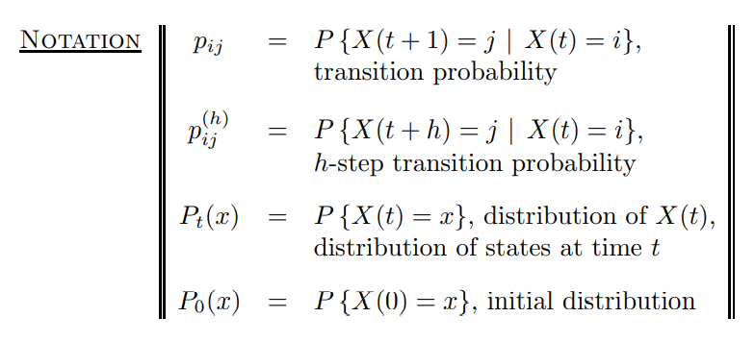
Characteristics of a Markov chain
Based on this data, we would like to compute:
n-step transition probabilities p_{ij}(n);
Q_{n} the distribution of states at time n, which is our forecast for X_{n};
The limit of p_{ij}(n); and Q_{n} as n → ∞, which is our long-term forecast.

Slide 14
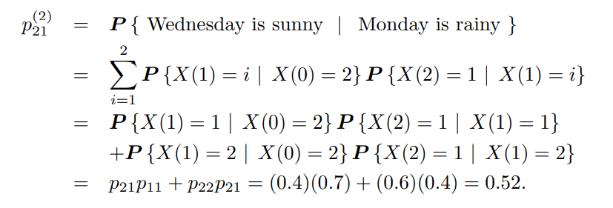
n-step Transition Probabilities
0.7
0.3
0.6
sunny
rainy
We may be interested in
It rains on Monday. Make forecasts for Wednesday, and Thursday. (For weather forecast example with above FSM)
Mathematically
p₂₁(2) = P { Wednesday is sunny | Monday is rainy }
More generally
If a Markov chain in state i at time m, what is the probability that n periods later the Markov chain will be in state j
ie. P(X_{m+n} = j |X_{m} = i) = ?
0.4

Slide 15
n-step Transition Probabilities
Since we are dealing with stationary Markov chain, we can write
P(X_{m+n} = j |X_{m} = i) = P(X_{n} = j |X₀ = i) =p_{ij}(n)
p_{ij}(n) = n-step probability of transition from state i to state j
If
Cleary p_{ij}(1)= p_{ij}
Matrix P^{n} represents n-step transition probabilities from any state i to state j
How will you find P^{n} ?

Slide 16
n-step Transition Probabilities
p_{ij}(2)= probability that the system will be in state j two periods from now, considering it is now in state i
To compute p_{ij}(2), we must go from state i to some state k, then form state k to state j
Clearly right side of the eq^{n} is the
scalar product of i^{th} row of matrix P
with j^{th} column of matrix P
Hence, p_{ij}(2) is the ij^{th} element of matrix P.P = P²
i.e. Matrix P² represents 2-step transition probabilities for all states i, j
p_{i1}
1
p_{1j}
p_{i2}
2
p_{2j}
i
:
j
p_{ik}
p_{kj}
k
p_{is}
:
p_{sj}
s
Time 1
Time 2

Slide 17
Markov chain Weather example (cont)
p₂₁(2) = P { Wednesday is sunny | Monday is rainy }
state 1 = “sunny” state 2 = “rainy.
=p₂₁p₁₁ + p₂₂p₂₁
= (0.4)(0.7) + (0.6)(0.4)
= 0.52.
0.7
0.3
0.6
sunny
rainy
0.4

Slide 18
Markov chain Coke vs. Pepsi Example (cont)
Given that a person is currently a Pepsi purchaser, what is the probability that he will purchase Coke two purchases from now?
Pr[ Pepsi→?→Coke ] =
Pr[ Pepsi→Coke→Coke ] + Pr[ Pepsi→ Pepsi →Coke ] =
0.2 * 0.9 + 0.8 * 0.2 = 0.34
Pepsi → ?
? → Coke

Slide 19
Markov chain Coke vs. Pepsi Example (cont)
Given that a person is currently a Coke purchaser, what is the probability that he will purchase Pepsi three purchases from now?

Slide 20
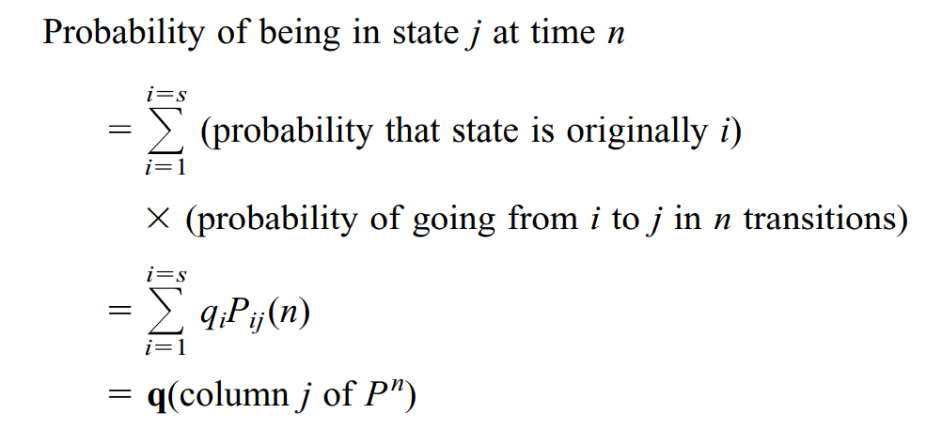

Unconditional State Probabilities (Winston-930)
One or n-step transition probabilities are conditional prob.
For ex. P(X_{n} = j |X₀ = i) =p_{ij}(n)
Sometimes, we may not know the state of the Markov chain at time 0, but we are interested to determine the prob. that the system is in state j at time n
That is P(X_{n} = j ) = ?

Slide 21
Rainy and sunny
Weather example
Suppose now that it does not rain yet, but meteorologists predict an 80% chance of rain on Monday. How does this affect our forecasts?
For Tuesday: Q*P=
For Wednesday: Q*P2=
For Thusday : Q*P3=

Slide 22
Unconditional State Probabilities
For, P(X_{n} = j ) = ?
it is necessary to specify prob. distribution of initial state
i.e. P(X₀ = i ) for all states i,
let it be vector Q₀, where q_{i}⁰= P(X₀ = i ) for all states i
Then,
q₁⁰
1
P_{1j}(n)
q₂⁰
2
P_{2j}(n)
:
j
q_{k}⁰
P_{kj}(n)
k
:
q_{s}⁰
P_{sj}(n)
s
Time 0
Time n

Slide 23
Markov chain Coke vs. Pepsi Example (cont)
Assume each person makes one cola purchase per week
Suppose 60% of all people now drink Coke, and 40% drink Pepsi
What fraction of people will be drinking Coke three weeks from now?
Q_{i} - the distribution in week i
Q₀=(0.6,0.4) - initial distribution
P[X₃=Coke] = Q₀ * (1st column of P³) = [0.6 0.4] * [0.781 0.438]^{T}
= 0.6 * 0.781 + 0.4 * 0.438 = 0.6438
Q₃= Q₀ * P³ =(0.6438,0.3562)

Slide 24
Classification of States in Markov Chain( winston: 931)
We now know probabilities associated with states
We can classify the states of the system
Whether you can get from one state to another
Whether you can return to a state
To help in classifying states, we use a state diagram from the weather example:
0.4
0.6
0.8
rain
no rain
0.2

Slide 25
Classification of States – Definitions
Path - a sequence of transitions from state i to state j exists and has positive probability, i.e., p_{ij}(n)>0 for some n.
State j is Reachable from state i if there is a path from i to j
Two states, i and j, Communicate (i ↔ j) if j is reachable from i, and i is reachable from j.

Slide 26
Classification of States – Definitions (cont)
A set of states S in a Markov Chain is a closed set if
All the states of S communicate with each other, and
No state outside of S is reachable.
.6
.7
.4
1
.5
2
.5
.3
3
4
.4
.5
.8
.1
5
S₁
.2
S₂

Slide 27
Classification of States – Definitions (cont)
Irreducible Markov Chain - if there is only one Closed set
Eg. Weather, Coke vs Pepsi
A state i is an Absorbing state if the process never will leave the state
i.e. the state returns to itself with certainty in one transition
p_{ii} = 1 (closed set with 1 member)
Example of Absorbing State - The Gambler’s Ruin
At each play we have the following:
Gambler wins $1 with probability p, or loses $1 with probability 1-p
Game ends when gambler goes broke, or gains a fortune of $N
Then both $0 and $N are absorbing states

Slide 28
Classification of States – Definitions (cont)
A state i is a Transient state if the process may never return the state again.
i.e. there exists a state j that is reachable from i, but i is not reachable from j.
Mathematically,
A state is Recurrent if– upon entering the state, the process definitely will return the state again.
if and only if it is not transient.

Slide 29
Classification of States – Definitions (cont)
Example – Gardener Problem
Chemical test to check soil condition
New season productivity
State 1 – Good; State 2 – Fair; State 3 – Poor
Gardener observed – last year soil condition
impacts currents year productivity
Ex- Gardener Problem
State 1, 2 transient
Can reach state 3 but never be reached back
State 3 absorbing - p₃₃=1
.5
.2
1
2
.5
.3
.5
3
1

Slide 30
Classification of States – Definitions (cont)
Ex- Gardener Problem
State 1, 2 transient
Can reach state 3 but never be reached back
State 3 absorbing - p₃₃=1
Ex- Gambler Ruin (simple case – Quits when $0 or $4)
State 2 – Transient or Recurrent?
Ans. Transient
.5
.2
1
2
.5
.3
.5
3
1
1-p
p
p
p
1
0
1
2
3
4
1
1-p
1-p

Slide 31
Classification of States – Definitions (cont)
State i is periodic with period t > 1 if t is the smallest number such that all paths leading from state i back to state i have a length which is a multiple of t
i.e a return is possible only in t, 2t, 3t, … steps
Mathematically, p_{ii}(n) = 0 whenever n is not divisible by t
A recurrent state that is not periodic is called aperiodic

Slide 32
Classification of States – Definitions (cont)
.6
1
2
1
.6
.4
.4
3
Continuing with n = 6, 7, … P^{n} shows that p₁₁ and p₃₃ are (+)ve for even n and 0 otherwise
i.e. states 1 and 3 have period 2

Slide 33
Classification of States – Definitions (cont)
If all states in a Markov Chain are recurrent, aperiodic, and communicate with one another (a “nice” chain), then the Markov Chain is said to Ergodic
Example –
Gambler Ruin
Not Ergodic 0,1,2,3,4 state but 0 and 4 do not communicate each other
Weather
Ergodic
Coke vs Pepsi
Ergodic
Gardener
Not Ergodic

Slide 34
Long Run Property of Markov Chain Steady State Probabilities
n-step transition probabilities for Cola drinkers
After long time a person’s next cola purchase probability doesn’t depend on
Whether (s)he was initially Coke or Pepsi drinker

Slide 35
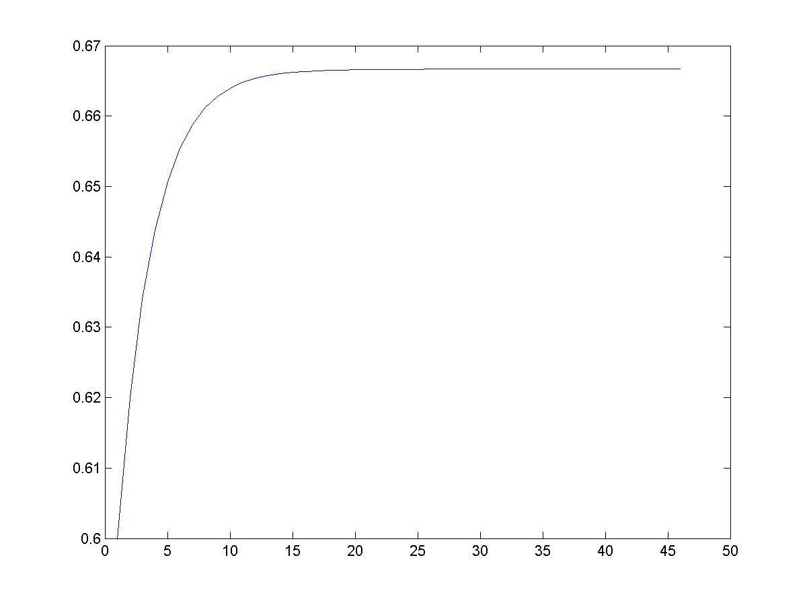
Markov Chain Coke vs. Pepsi Example (cont)
Simulation:
2/3
Pr[X_{i} = Coke]
stationary distribution
0.9
0.1
0.8
coke
pepsi
0.2
week - i

Slide 36
Long Run Property of Markov Chain Steady State Probabilities
THEOREM: Let P be the transition matrix for a s-state ergodic chain, then there exists a vector π = [ π₁ π₂ π₃ …. π_{s} ] such that
Recall that ij^{th} element of P^{n} is p_{ij}(n), so theorem tells that
π_{j} are called the steady state probabilities
Vector π is called steady state/ equilibrium distribution
Steady state
doesn’t mean that the process settle down to one state
Means - Prob. of process in state j, after long time, tends to π_{j} , and independent of initial state distribution

Slide 37
Long Run Property of Markov Chain Steady State Probabilities
How can we find π ?
From theorem, for large n, and all i p_{ij}(n+1) ≅ p_{ij}(n) = π_{j} ……… (1)
Since p_{ij}(n+1) = (i^{th} row of P^{n}) × (j^{th} column of P)
………. (2)
If n is large, substituting eq^{n} (1) into (2)
In matrix form, π = π P ………………… (3)
Unfortunately, eq^{n} (3) has infinite no. of solutions
To have unique solution, along with eq^{n} (3), use
That is, solve the system of eq^{n}

Slide 38
Long Run Property of Markov Chain Steady State Probabilities
Coke vs Pepsi Example
Suppose, 100 million cola customer, each person purchase 1 cola during any week
Each selling profits $1
For $500 million per year, an add firm guarantees to decrease 10% to 5% of Coke customers who switch to Pepsi after a purchase
Should Coke company hire the add firm?

Slide 39
Long Run Property of Markov Chain Steady State Probabilities
Coke vs Pepsi Example
Total cola purchase in a year (52 week)
= 100 * 10⁶ * 52= 5.2 billion
Each purchase earns $1 profit for a company
Current profit in a year for Coke company
= 2/3 (5.2 billion * $1) [ since steady state prob. of buying coke π₁= 2/3]
=$3,466,666,667
What the add firm offers to Coke company is for $500 million per year

Slide 40
Long Run Property of Markov Chain Steady State Probabilities
Then what will be the long run/steady state probabilities?
Lets find.
New profit in a year for Coke company will be
= 0.8 * (5.2 billion * $1) - $500 million
=$3,660,000,000
So, they should hire the add firm

Slide 41
Long Run Property of Markov Chain Steady State Probabilities
Gardener Problem (with fertilizer)
System of eq^{n} yields following set of equations
Therefore, π = [.1017 .5254 .3729]

Slide 42


Mean First Passage Times
For an ergodic chain, let m_{ij} = expected number of transitions before we first reach state j, given that we are currently in state i; m_{ij} is called the mean first passage time from state i to state j.
assume we are currently in state i. Then with probability p_{ij}, it will take one transition to go from state i to state j.
For k ≠ j, we next go with probability p_{ik} to state k. In this case, it will take an average of 1 + m_{kj} transitions to go from i and j.
This reasoning implies
Since

Slide 43
Mean First Passage Times
By solving the linear equations of the equation above, we find all the mean first passage times.
It can be shown that mean recurrence time
For the cola example, π₁=2/3 and π₂ = 1/3
Hence, m₁₁ = 1.5 and m₂₂ = 3
m₁₂ = 1 + p₁₁m₁₂ = 1 + .9m₁₂
m₂₁ = 1 + p₂₂m₂₁ = 1 + .8m₂₁
Solving these two equations yields,
m₁₂ = 10 and m₂₁ = 5

